Slide 1
Automotive Safety
Review 3

Slide 2
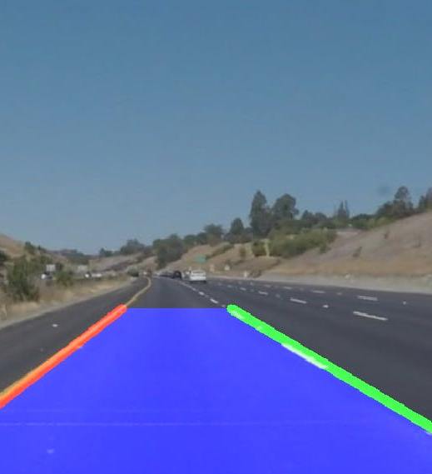
PROJECT TITLE
Lane Detection

Slide 3
TEAM MEMBERS
AARSHA MITHRA VAVILALA -19BMA0035
YANDRA MURALI MANOHAR - 19BMA0003
MEET BHANUSHALI-19BMA0061

Slide 4
Abstract
Identifying lanes on the road is a common task performed by all human drivers to ensure their vehicles are within lane constraints when driving, so as to make sure traffic is smooth and minimize chances of collisions with other cars in nearby lanes. Similarly, it is a critical task for an autonomous vehicle to perform. Autonomous Vehicles are using Commuter vision based systems for this as a part of Localization and being used in autonomous vehicles starting from Level 1(Based on 5 levels of Autonomy).In this project we will be using Computer Vision techniques to perform the same.

Slide 5
objectives
To detect lanes on roads using a monocular camera in several ODD.
To find the central offset of the vehicle

Slide 6
APPLICATIONS
DRIVER ASSISTANCE
LANE DEPARTURE WARNING
LANE KEEPING SYSTEMS

Slide 7
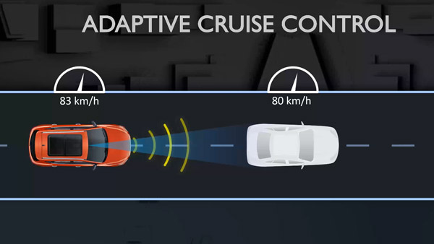
ADAPTIVE CRUISE CONTROL (acc)
ACC uses Lane Keeping in addition to several other sensors.

Slide 8
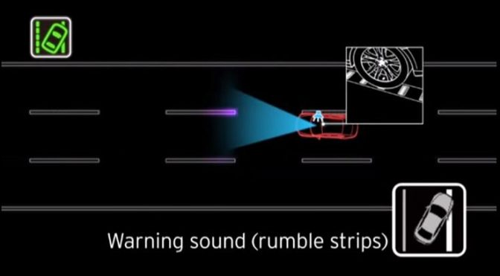
Lane departure crashes
Lane departure crashes occur when a vehicle drifts out of its lane and either runs off the road to the right or moves into the path of oncoming traffic to the left. While lane departure accidents are usually attributed to driver error, there are a number of reasons why a car might drift. Lane detection system keeps traqck on the lane marks and helps minimize these accidents.

Slide 9
PROCEDURE
Isolate Pixels That Could Represent Lane Lines
The first part of the lane detection process is to apply thresholding to each video frame so that we can eliminate things that make it difficult to detect lane lines. By applying thresholding, we can isolate the pixels that represent lane lines.

Slide 10
procedure
Thresholding Steps
1. Convert the video frame from BGR (blue, green, red) color space to HLS (hue, saturation, lightness).
The HLS color space is better than the BGR color space for detecting image issues due to lighting, such as shadows, glare from the sun, headlights, etc. We want to eliminate all these things to make it easier to detect lane lines. For this reason, we use the HLS color space, which divides all colors into hue, saturation, and lightness values.
2. Perform Sobel edge detection on the L (lightness) channel of the image to detect sharp discontinuities in the pixel intensities along the x and y axis of the video frame.
Sharp changes in intensity from one pixel to a neighboring pixel means that an edge is likely present. We want to detect the strongest edges in the image so that we can isolate potential lane line edges.

Slide 11
procedure
3. Perform binary thresholding on the S (saturation) channel of the video frame.
A high saturation value means the hue color is pure. We expect lane lines to be nice, pure colors, such as solid white and solid yellow. Both solid white and solid yellow, have high saturation channel values.
Binary thresholding generates an image that is full of 0s (black) and 255 (white) intensity values. Pixels with high saturation values (e.g. > 80 on a scale from 0 to 255) will be set to white, while everything else will be set to black.
4. Perform binary thresholding on the R (red) channel of the original BGR video frame.
This step helps extract the yellow and white color values, which are the typical colors of lane lines.
Remember, pure white is bgr(255, 255, 255). Pure yellow is bgr(0, 255, 255). Both have high red channel values.
To generate our binary image at this stage, pixels that have rich red channel values (e.g. > 120 on a scale from 0 to 255) will be set to white. All other pixels will be set to black.

Slide 12
procedure
5. Perform the bitwise and operation to reduce noise in the image caused by shadows and variations in the road color.
Lane lines should be pure in color and have high red channel values. The bitwise AND operation reduces noise and blacks-out any pixels that don’t appear to be nice, pure, solid colors (like white or yellow lane lines.)

Slide 13
PROCEDURE
Apply Perspective Transformation to Get a Bird’s Eye View
from the perspective of the camera mounted on a car below, the lane lines make a trapezoid-like shape. We can’t properly calculate the radius of curvature of the lane because, from the camera’s perspective, the lane width appears to decrease the farther away you get from the car.
Imagine you’re a bird. You’re flying high above the road lanes below. From a birds-eye view, the lines on either side of the lane look like they are parallel.
For the first step of perspective transformation, we need to identify a region of interest (ROI). This step helps remove parts of the image we’re not interested in. We are only interested in the lane segment that is immediately in front of the car.

Slide 14
procedure
Identify Lane Line Pixels
Set Sliding Windows for White Pixel Detection.
Fill in the Lane Line.
Overlay Lane Lines on Original Image.
Calculate Lane Line Curvature.
Calculate the Center Offset.
Display Final Image.
Detect Lane Lines in a Video.
Troubleshooting.

Slide 15
Expected progress per review
Review 1-Lane detection in a still image
Review 2-Lane detection in a Video
Review 3-Optimization of code and Report.

Slide 16
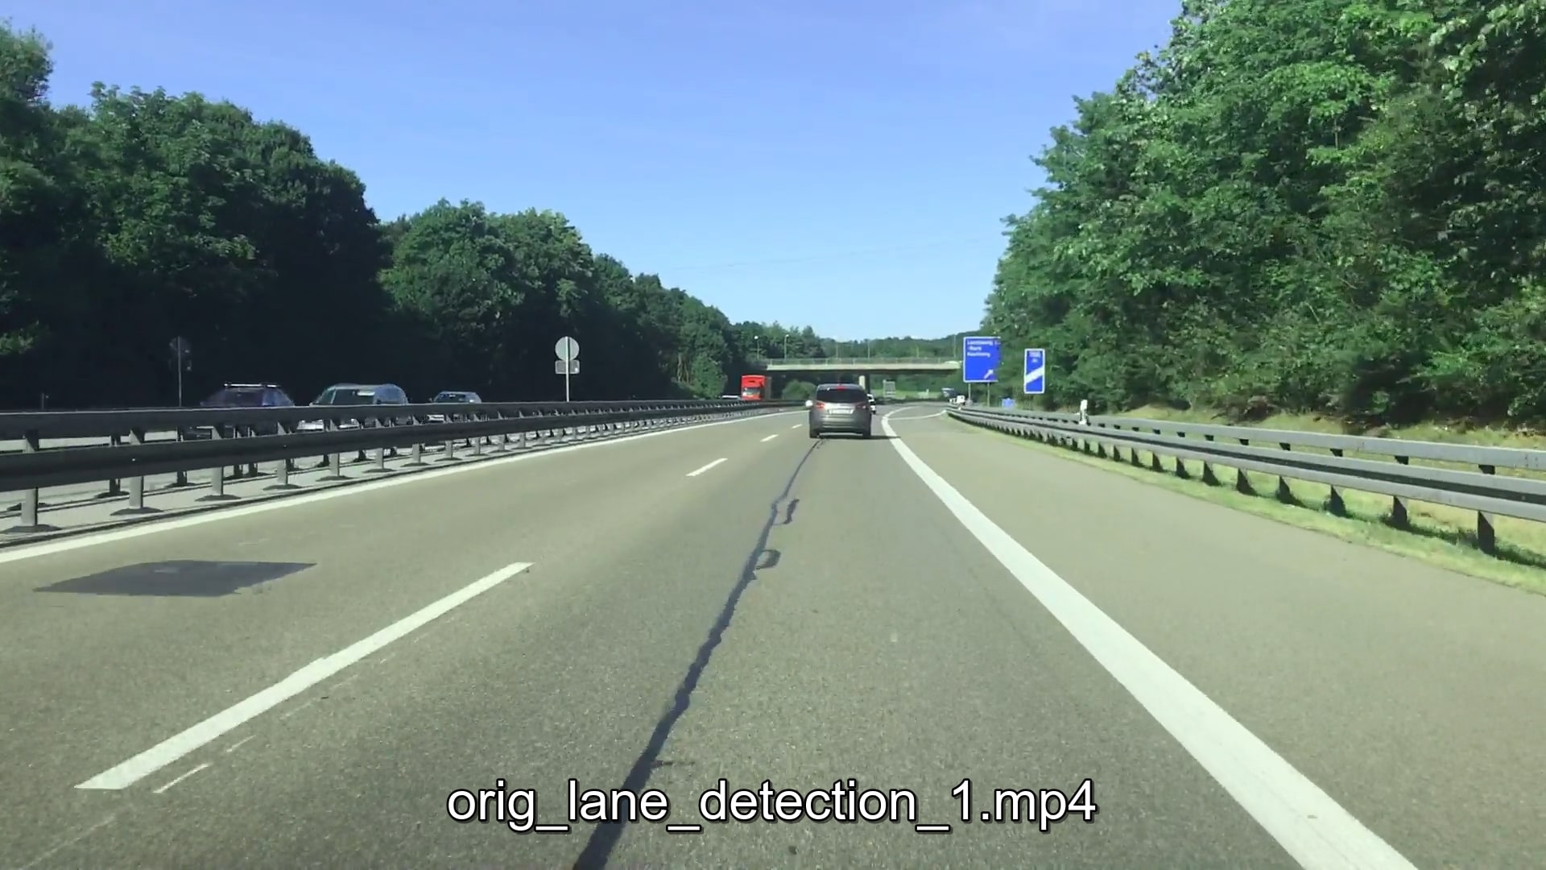
Progress
Applied the methods stated earlier to detect lanes in a still image
Input

Slide 17
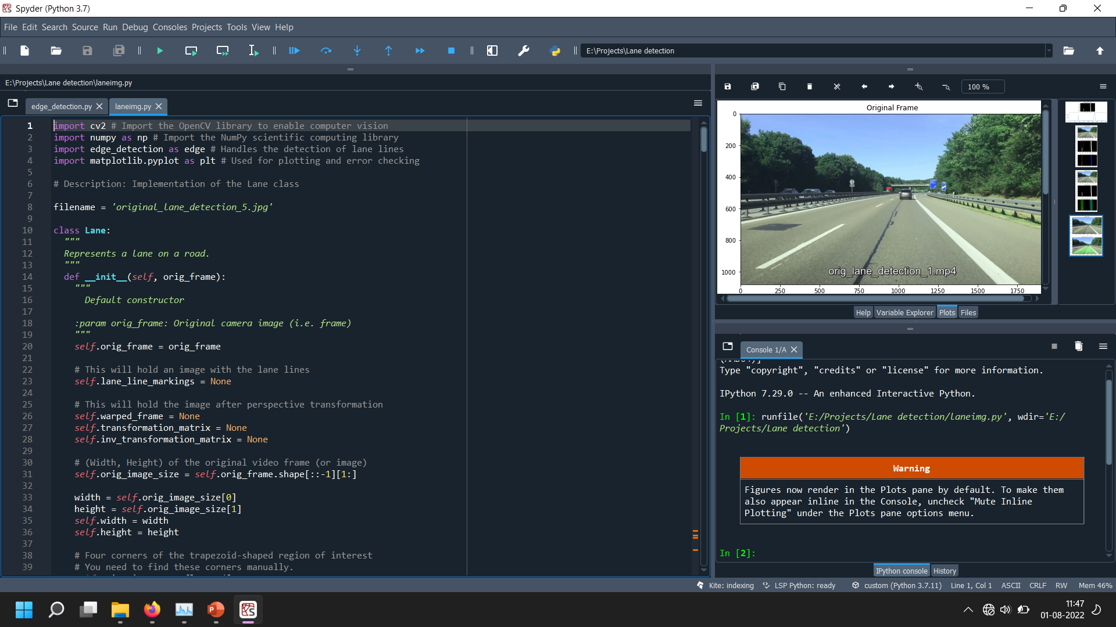
Link for edge_detection.py https://github.com/ZeBread/TARP/blob/main/edge_detection.py
Link for laneimg.py https://github.com/ZeBread/TARP/blob/main/laneimg.py

Slide 18
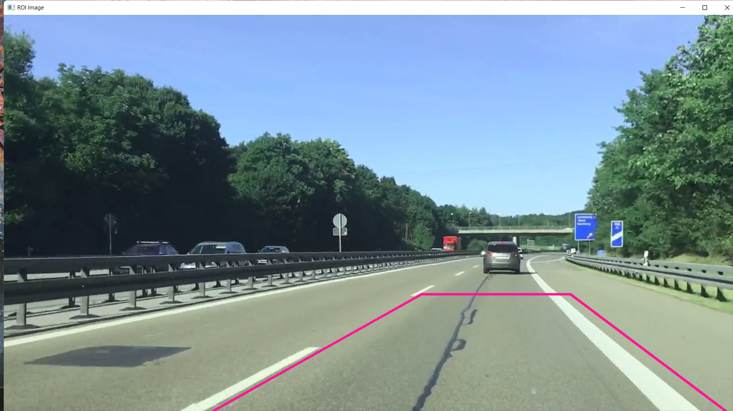
ROI in a IMAGE

Slide 19
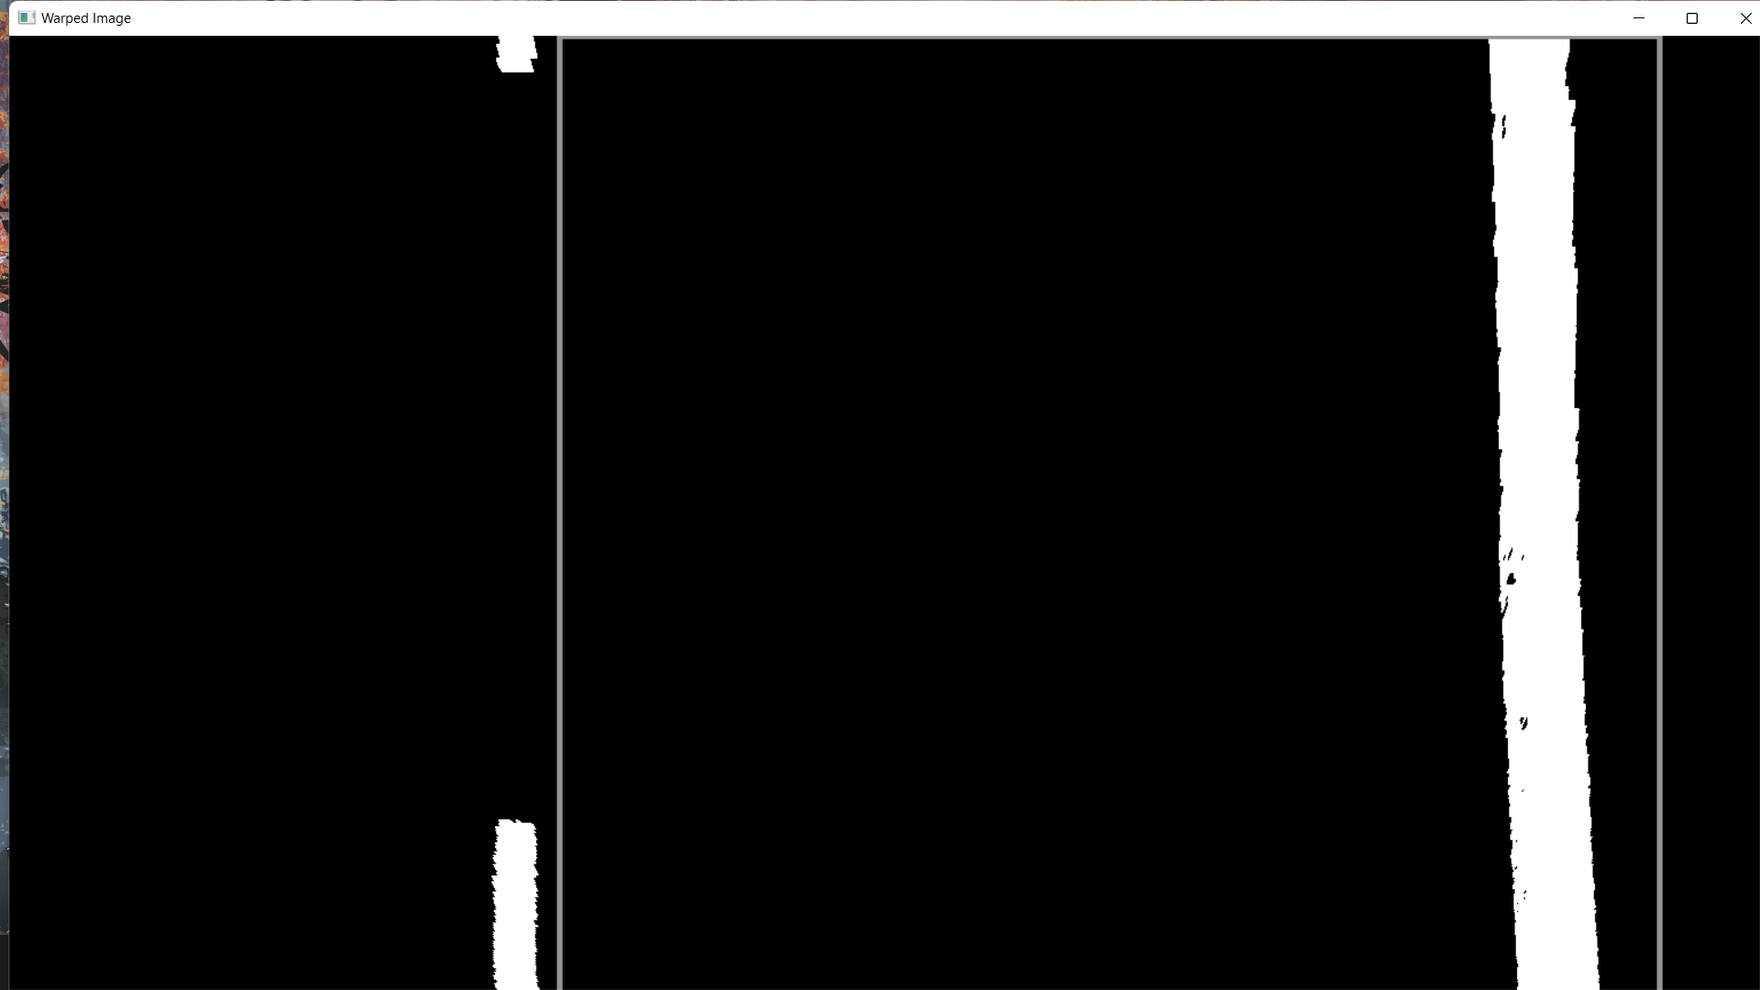
Warped ROI

Slide 20
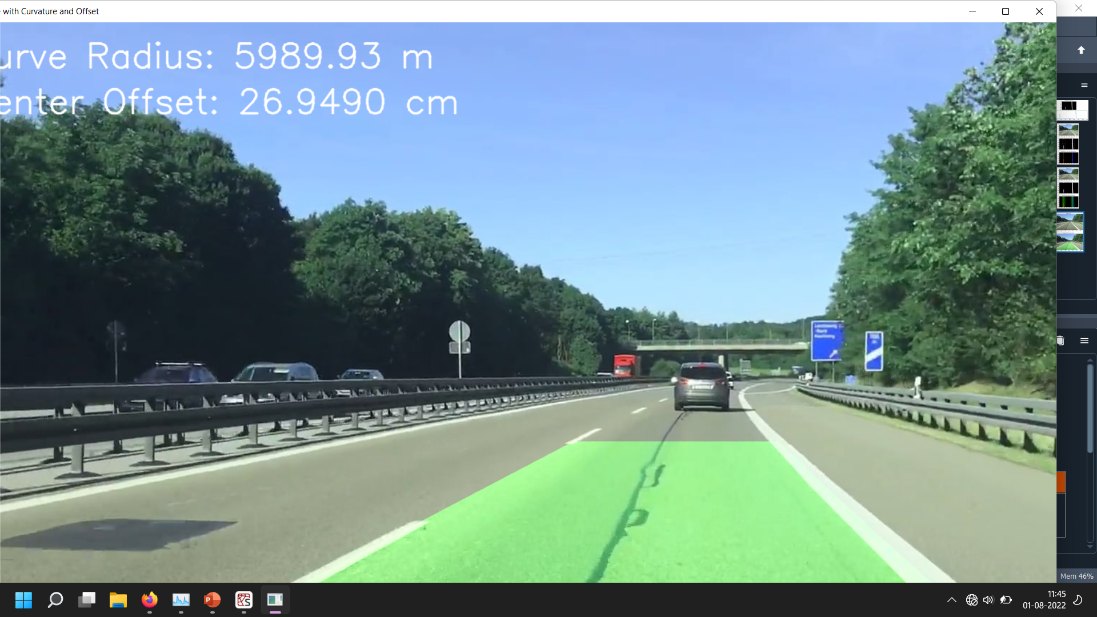
Lane and central offset

Slide 21
LANE AND CENTRAL OFFSET IN A VIDEO
some minor changes were made to the main method in laneimg.py to accommodate video frames as opposed to images.
Link for edge_detection.py
https://github.com/ZeBread/TARP/blob/main/edge_detection.py
Link for lane.py
https://github.com/ZeBread/TARP/blob/main/lane.py

Slide 22
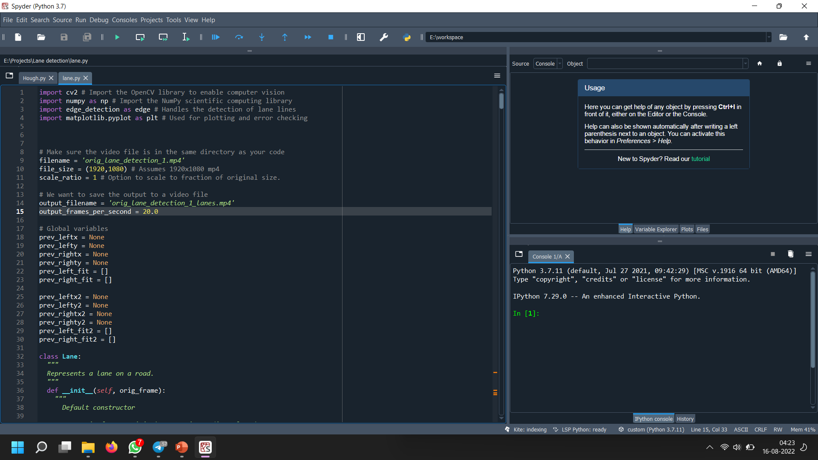
Lane and central offset in a VIdeo

Slide 23
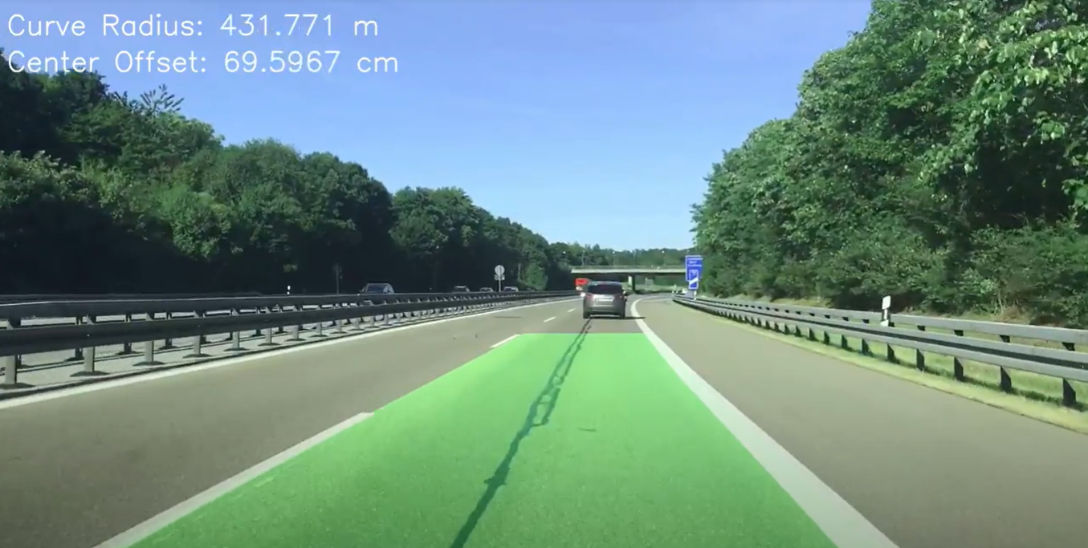
Link for input video https://drive.google.com/file/d/1ZjPDa4dgR1MGcy7cVTZBBDLTVZM0jhu-/view?usp=sharing
Link for output video https://drive.google.com/file/d/13EK-0_8JcVBAzRa-szhR36bBjj6KeUYK/view?usp=sharing

Slide 24
Approach 2 hough transform pROCEDURE
Step-1-Processing a video
We will feed in our sample video for lane detection as a series of continuous frames (images) by intervals of 10 milliseconds. We can also quit the program anytime by pressing the ‘q’ key.
Step-2-Applying Canny Detector
The Canny Detector is a multi-stage algorithm optimized for fast real-time edge detection. The fundamental goal of the algorithm is to detect sharp changes in luminosity (large gradients), such as a shift from white to black, and defines them as edges, given a set of thresholds. The Canny algorithm has four main stages:

Slide 25
STAGES IN CANNY DETECTOR
A. Noise reduction
As with all edge detection algorithms, noise is a crucial issue that often leads to false detection. A 5x5 Gaussian filter is applied to convolve (smooth) the image to lower the detector’s sensitivity to noise. This is done by using a kernel (in this case, a 5x5 kernel) of normally distributed numbers to run across the entire image, setting each pixel value equal to the weighted average of its neighboring pixels.
B. Intensity gradient
The smoothened image is then applied with a Sobel, Roberts, or Prewitt kernel (Sobel is used in OpenCV) along the x-axis and y-axis to detect whether the edges are horizontal, vertical, or diagonal.

Slide 26
STAGES IN CANNY DETECTOR
C. Non-maximum suppression
Non-maximum suppression is applied to “thin” and effectively sharpen the edges. For each pixel, the value is checked if it is a local maximum in the direction of the gradient calculated previously.
D. Hysteresis thresholding
After non-maximum suppression, strong pixels are confirmed to be in the final map of edges. However, weak pixels should be further analyzed to determine whether it constitutes as edge or noise. Applying two pre-defined minVal and maxVal threshold values, we set that any pixel with intensity gradient higher than maxVal are edges and any pixel with intensity gradient lower than minVal are not edges and discarded. Pixels with intensity gradient in between minVal and maxVal are only considered edges if they are connected to a pixel with intensity gradient above maxVal.

Slide 27
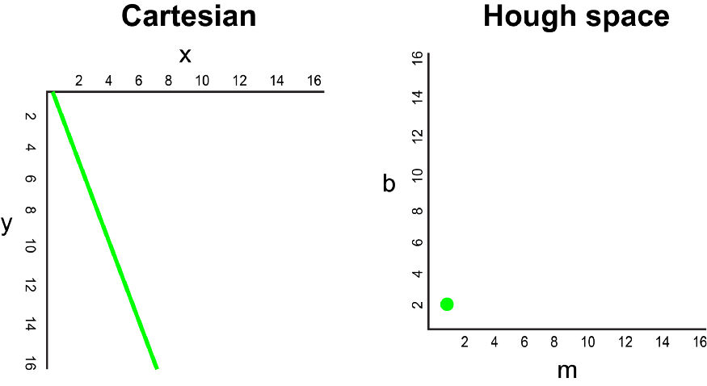
pROCEDURE
Step-3-Segmenting lane area
We will handcraft a triangular mask to segment the lane area and discard the irrelevant areas in the frame to increase the effectiveness of our later stages.
Step-4-Hough transform
In the Cartesian coordinate system, we can represent a straight line
as y = mx + b by plotting y against x.
However, we can also represent this line as a single point in
Hough space by plotting b against m. For example, a line with
the equation y = 2x + 1
may be represented as (2, 1) in Hough space.

Slide 28
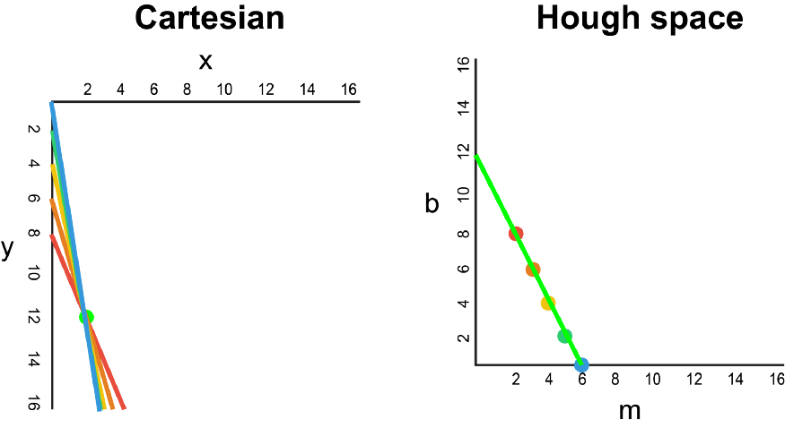
pROCEDURE
Now, what if instead of a line, we had to plot a point in the Cartesian coordinate system. There are many possible lines which can pass through this point, each line with different values for parameters m and b. For example, a point at (2, 12) can be passed by y = 2x + 8, y = 3x + 6, y = 4x + 4, y = 5x + 2, y = 6x, and so on. These possible lines can be plotted in Hough space as (2, 8), (3, 6), (4, 4), (5, 2), (6, 0). Notice that this produces a line of m against b coordinates in Hough space.

Slide 29
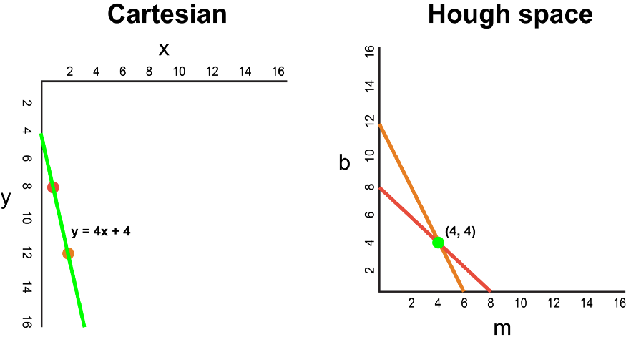
PROCEDURE
Whenever we see a series of points in a Cartesian coordinate system and know that these points are connected by some line, we can find the equation of that line by first plotting each point in the Cartesian coordinate system to the corresponding line in Hough space, then finding the point of intersection in Hough space.
The point of intersection in Hough space represents
the m and b values that pass consistently
through all of the points in the series.

Slide 30
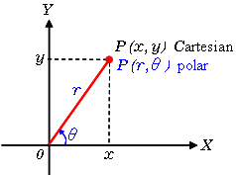
PROCEDURE
Since our frame passed through the Canny Detector may be interpreted simply as a series of white points representing the edges in our image space, we can apply the same technique to identify which of these points are connected to the same line, and if they are connected, what its equation is so that we can plot this line on our frame.
For the simplicity of explanation, we used Cartesian coordinates to correspond to Hough space. However, there is one mathematical flaw with this approach: When the line is vertical, the gradient is infinity and cannot be represented in Hough space. To solve this problem, we will use Polar coordinates instead.
The process is still the same just that other than plotting m against b in Hough space,
we will be plotting r against θ.

Slide 31
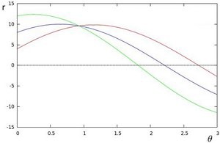
PROCEDURE
For example, for the points on the Polar coordinate system with x = 8 and y = 6, x = 4 and y = 9, x = 12 and y = 3, we can plot the corresponding Hough space.
We see that the lines in Hough space intersect at θ = 0.925 and r = 9.6. Since a line in the Polar coordinate system is given by r = xcosθ + ysinθ, we can induce that a single line crossing through all these points is defined as 9.6 = xcos0.925 + ysin0.925.

Slide 32
PROCEDURE
Generally, the more curves intersecting in Hough space means that the line represented by that intersection corresponds to more points. For our implementation, we will define a minimum threshold number of intersections in Hough space to detect a line. Therefore, Hough transform basically keeps track of the Hough space intersections of every point in the frame. If the number of intersections exceeds a defined threshold, we identify a line with the corresponding θ and r parameters.
We apply Hough Transform to identify two straight lines — which will be our left and right lane boundaries
Step-5-Visualization
The lane is visualized as two light green, linearly fitted polynomials which will be overlayed on our input frame.

Slide 33
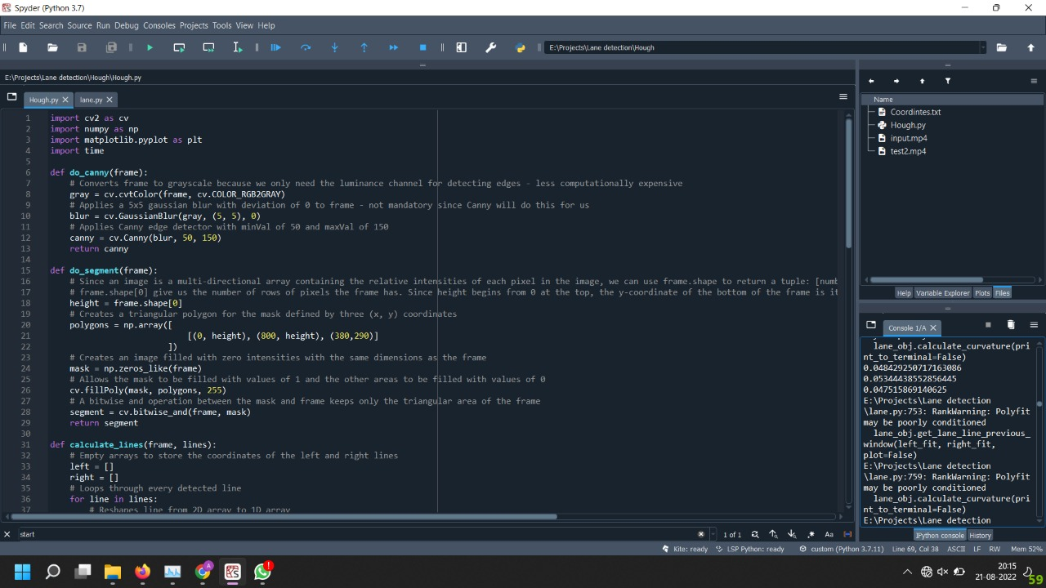
code
Code link https://github.com/ZeBread/CompVis/blob/main/Hough.py

Slide 34
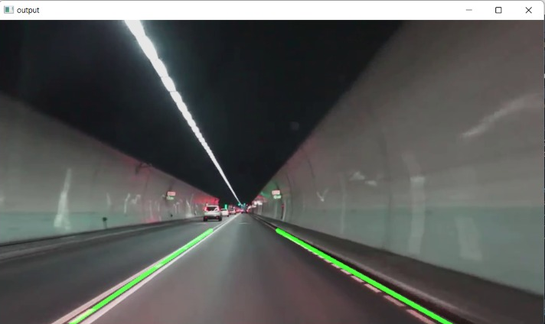
OUTPUT

Slide 35
Ultra Fast lane detection
Based on paper titled “Ultra Fast Structure-aware Deep Lane Detection”
We have taken this CNN approach and have used the training weights provided by the author trained on CULANE and TuSimple dataset and have incorporated in our CV algorithm for the lane detection purpose.
The F1-score combines the precision and recall of a classifier into a single metric by taking their harmonic mean.

Slide 36
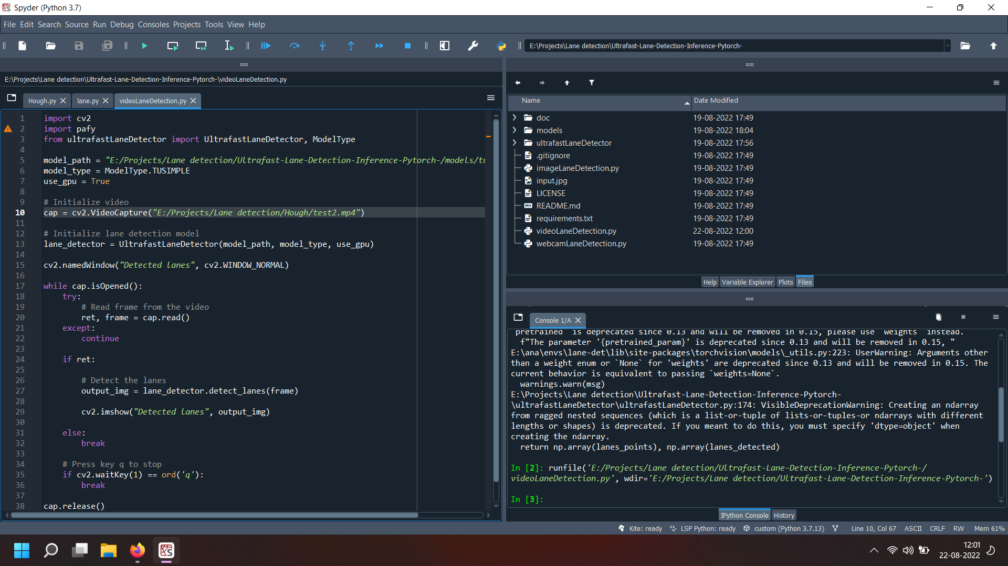
Code

Slide 37
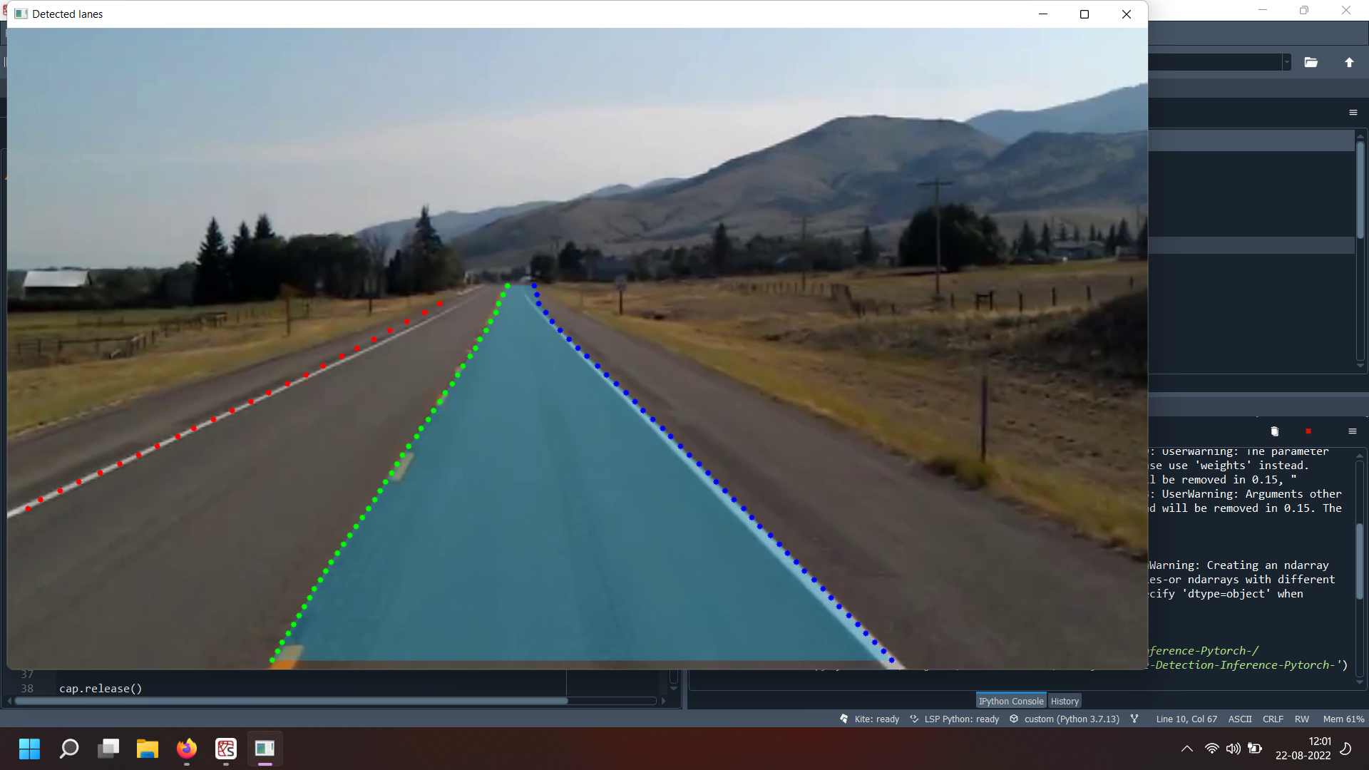
Output

Slide 38
references
https://ieeexplore.ieee.org/document/6240859
https://scholar.google.co.in/scholar_url?url=https://ieeexplore.ieee.org/abstract/document/6869550/&hl=en&sa=X&ei=-K_7YqSyGcyzywSmhqSYAQ&scisig=AAGBfm339W69KZyt6yfTnau7P4ctCNj2Cw&oi=scholarr
https://scholar.google.co.in/scholar_url?url=https://islab.ulsan.ac.kr/files/announcement/328/An%2520Improved%2520Sobel%2520Edge%2520Detection.pdf&hl=en&sa=X&ei=ErD7YoXYJcilywSj0IOwAw&scisig=AAGBfm3lWQB24ILw-mtv1qcgj465IG51iw&oi=scholarr
https://arxiv.org/abs/2004.11757
https://scholar.google.co.in/scholar_url?url=https://link.springer.com/chapter/10.1007/978-3-319-12637-1_57&hl=en&sa=X&ei=mbD7YqOQN8ilywSj0IOwAw&scisig=AAGBfm1Dl5QIe9wGdC3l95iV6wcQ3QIEjg&oi=scholarr
https://scholar.google.co.in/scholar_url?url=https://openaccess.thecvf.com/content/CVPR2021W/MAI/papers/Mahendran_Computer_Vision-Based_Assistance_System_for_the_Visually_Impaired_Using_Mobile_CVPRW_2021_paper.pdf&hl=en&sa=X&ei=t7D7Yte9N4LgyASHm4OIDQ&scisig=AAGBfm11DM3P7nfht-5ZjORxzZtykntIhg&oi=scholarr
Curved Lane Detection using Improved Hough Transform and CLAHE in a Multi-Channel ROI (ijcaonline.org)
https://www.researchgate.net/publication/343789107_Comparative_Study_Between_Canny_and_Sobel_Edge_Detection_Techniques
https://learnopencv.com/hough-transform-with-opencv-c-python/
https://www.researchgate.net/publication/329800714_Performance_Analysis_of_Canny_and_Sobel_Edge_Detection_Algorithms_in_Image_Mining

Slide 39
THANK YOU!

